Slide 1
WEB SERVICES AND SERVICE ORIENTED ARCHITECTURE

Slide 2
Essential Concepts
Virtual Enterprise
Business Process Optimization
Issues in current Distributed Systems
Message Oriented Middleware
Loose Coupling
Choreography -Service solution composition
Service

Slide 3
SECTION 1
MOTIVATION FOR SOA

Slide 4
What is service?
These services represent some sort of publicized package of functionality and they are composeable.
For example, Transportation & credit card services.
Services are discoverable based on their descriptions, terms and conditions for use, and so on.
Metadata that fully describes the service.
Actual use of a service is often based on an agreed-upon contract with the provider.
Quality of services are, such as availability, cost, and other specified conditions that govern its use.

Slide 5
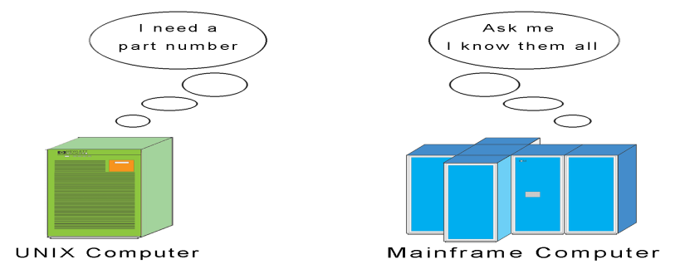
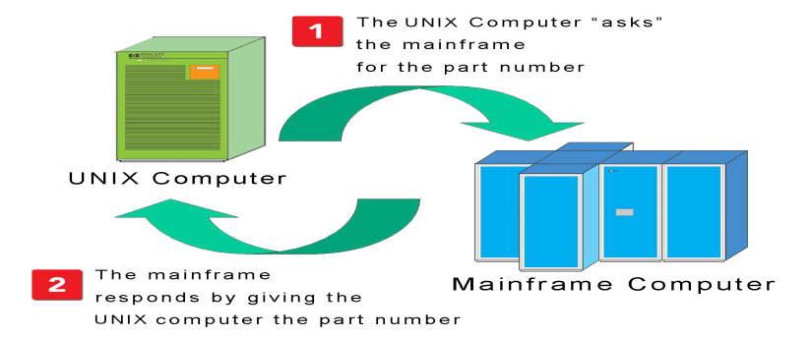
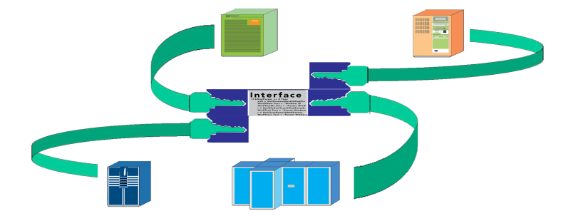
What is SOA? First, Understand “Tight Coupling”
Data and functionality typically reside on more than one system (and application)
Applications need to be able to “talk to each other”
Status quo: Proprietary or custom communication interfaces between applications
Source: H. Taylor, “Service-Oriented Architecture (SOA) 101 ‘What’s Hype, What’s Real?’“, Juniper Networks, Inc.,2007.

Slide 6
Challenges with Tight Coupling
While tight coupling is inherently sound, the following challenges are encountered in its implementation:
  It’s costly to maintain
  Slow and costly to change
  Cost and complexity compounded by multi-party scenarios such as B2B or integration with the public sector
  Cost and complexity of managing and changing a tightly coupled architecture makes business agility difficult (IT can’t keep up with business needs, but it’s not their fault)
  Does not support reuse!
Source: H. Taylor, “Service-Oriented Architecture (SOA) 101 ‘What’s Hype, What’s Real?’“, Juniper Networks, Inc.,2007.

Slide 7
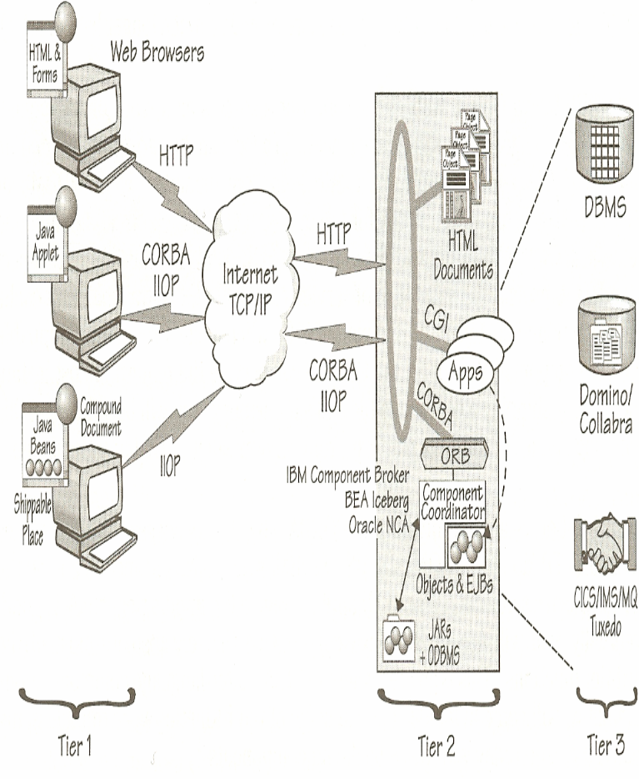
Challenges with Tight Coupling
Overview of CORBA
Tier1 belongs to traditional Web browsers and Web-centric applications
Tier 2 runs on any server that can support HTTP and CORBA clients CORBA objects, like EJBs, encapsulate business logic
Tier 3 consists of almost anything a CORBA object can access
Source: Client/Server Programming with JAVA and CORBA Second Edition by R. Orfali and D. Harkey, p. 45.

Slide 8
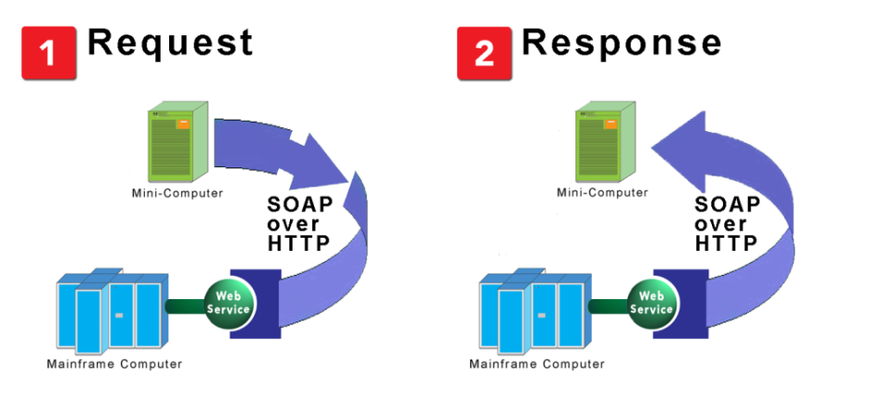
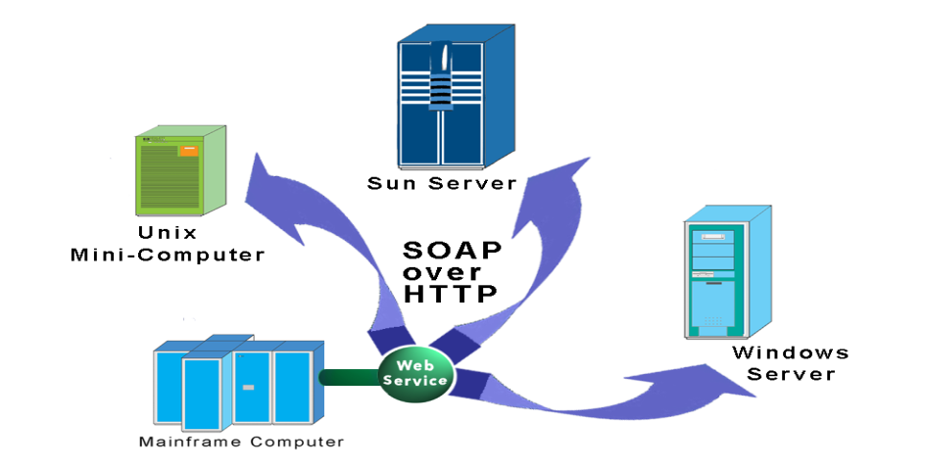
SOA: The Ideal of Open Interoperability (Loose Coupling)
SOA – A Definition
An IT architecture composed of software that has been exposed as “Services” – i.e. invoked on demand using a standard communication protocol.
“Web Services” – software available as a “service” using Internet protocols.
One software application talking to another using a standards-based (i.e. non-proprietary) language over a standards-based communication protocol.
Universal “Dial Tone” between software applications
An IT architecture that enables “loose coupling” of applications
Source: H. Taylor, “Service-Oriented Architecture (SOA) 101 ‘What’s Hype, What’s Real?’“, Juniper Networks, Inc.,2007.

Slide 9
Working Definition
A service-oriented architecture can be defined as a group of services, which communicate with each other. The process of communication involves either simple data passing or it could involve two or more services coordinating some activity. Some means of connecting services to each other is needed.
Note - Business process reengineering have been key influences driving the surfacing of SOA as an important architectural approach to business IT today.

Slide 10
SOA : Is a Specific Architectural Style that is concerned with loose coupling and dynamic binding between services.
Some critically important factors at the heart of SOA are necessary to make it work effectively.
Loosely Coupled : "the state in which the impact of change (change in consumers, providers, or cross-cutting policies) is minimized across dependencies."

Slide 11
The basic principles that underpin SOA
First, it is necessary to provide an abstract definition of the service, including the details that allow anyone who wants to use the service to bind to it in the appropriate way.
Second, those people who are the providers of services need to publish details of their services so that those who want to use them can understand more precisely what they do and can obtain the information necessary to connect to use them.
Third, those who require services need to have some way to find what services are available that meet their needs

Slide 12
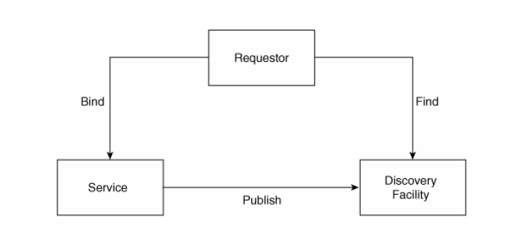
The SOA Triangle

Slide 13
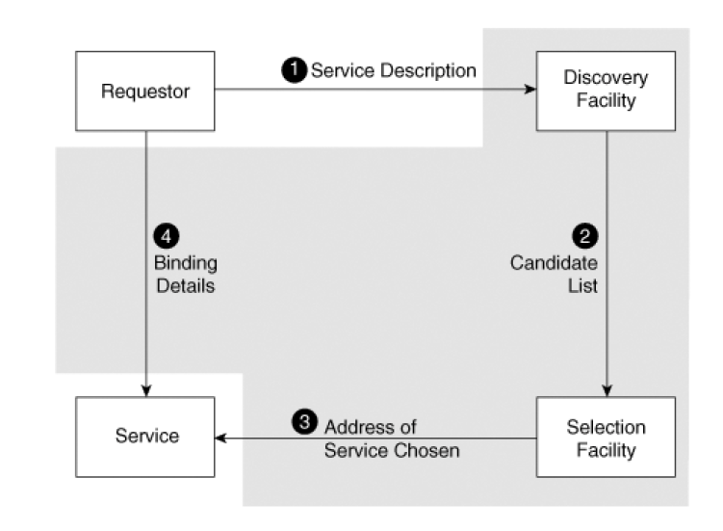
Selecting and binding services

Slide 14
Illustration of various steps and artifacts that dynamically discover & bind a service.
First, the requester describes the service needed via functions required and nonfunctional properties. Based on this input, the discovery facility produces a list of candidate services that satisfy those needs.
From this candidate list, the requester chooses a service. The selection facility shown for that purpose can be as simple as performing a random selection or as sophisticated as considering additional criteria such as cost of use.
After the requester has chosen the service, he determines its address and binding details, such as which protocol to use and which message format is required.
This information is either already returned within the candidate list details or is retrieved in a separate step.

Slide 15
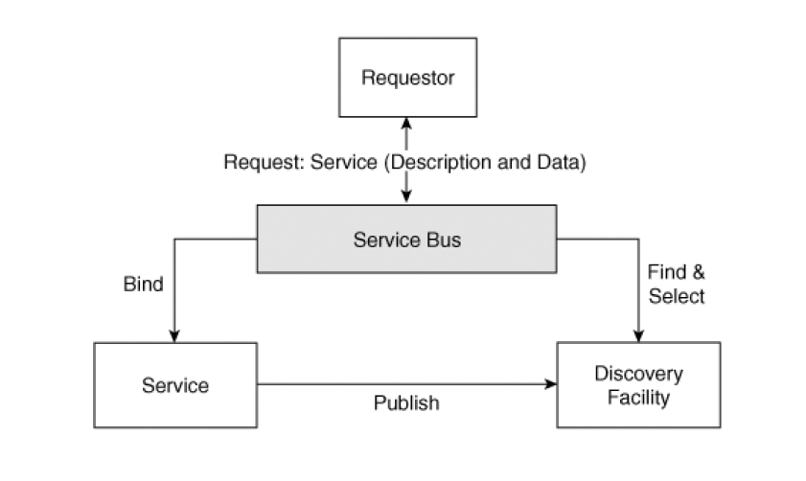

Slide 16
The role of the service bus in SOA
The functionality that a service bus provides goes beyond Virtualizing application functionality.
Thus, a requester might describe his need for processing power and storage to the bus, and the bus will make this available.
Of course, this requires much more sophistication, including scheduling features and extensions of the Web service model.

Slide 17
Core SOA Definitions
XML – Extensible Markup Language
SOAP – Simple Object Access Protocol
WSDL – Web Services Description Language
UDDI - Universal Description, Discovery and Integration
ESB – Enterprise Service Bus
Key Concepts
  Network Transparency
  Virtualized endpoint
  Self-describing software
  Universally discoverable software
  Universally understood software
  Machine to machine interaction
Source: H. Taylor, “Service-Oriented Architecture (SOA) 101 ‘What’s Hype, What’s Real?’“, Juniper Networks, Inc.,2007.

Slide 18
SOA Usage & Supporting Platforms
SOA Usage
  B2B
  Enterprise Application Integration (EAI)
  Application to Application
  Government
Major Players in SOA Space
  IBM: WebSphere SOA Product Suite
  BEA: Aqualogic (WebLogic)
  Oracle: Fusion Middleware
  Microsoft: .NET
  SAP: NetWeaver
Source: H. Taylor, “Service-Oriented Architecture (SOA) 101 ‘What’s Hype, What’s Real?’“, Juniper Networks, Inc.,2007.

